Slide 1
Assignment #1: Needfinding - Designing for Stress Behaviors
Nicholas Pyun, Taralyn Nguyen, Varsha Saravanan, Maroua Bezzaoui

Slide 2

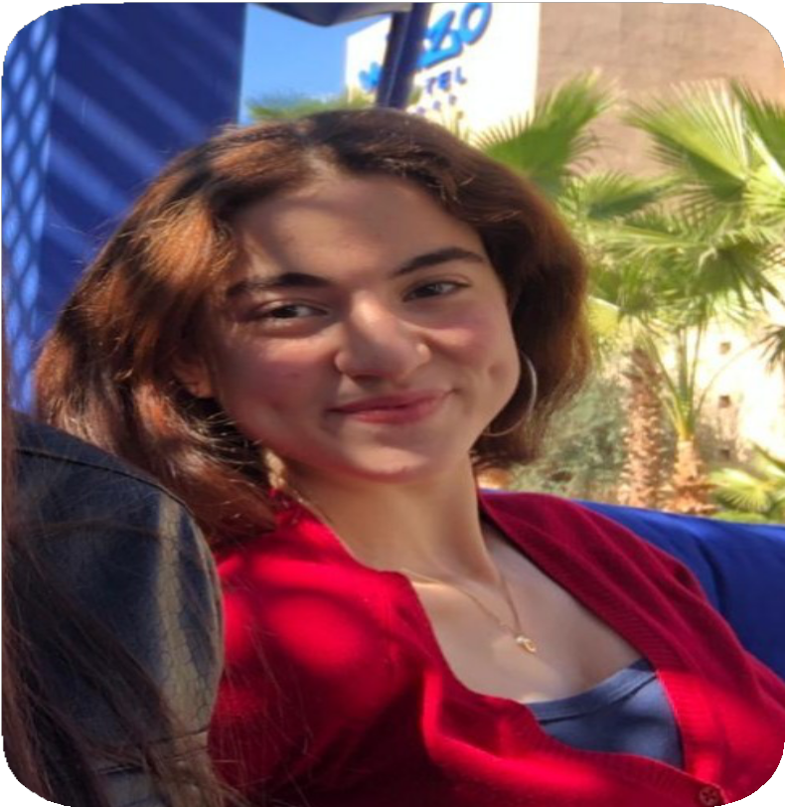

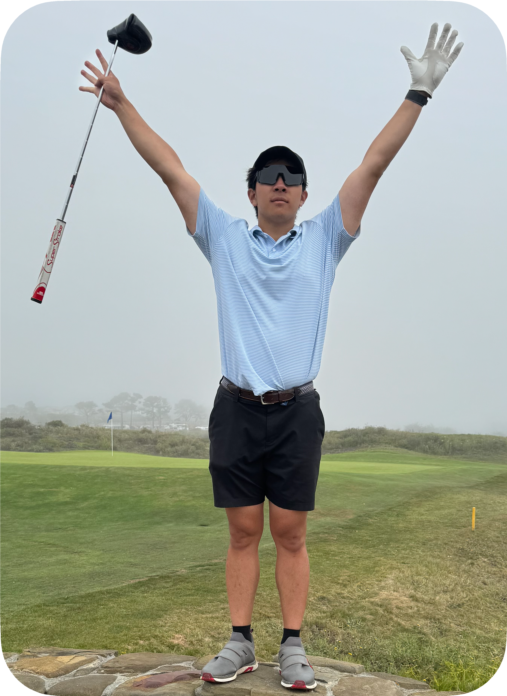
Team Members
Varsha Saravanan
Class of 2026
Computer Science,
Human Computer Interaction
Maroua Bezzaoui
Class of 2026
Computer Science,
Human Computer Interaction
Taralyn Nguyen
Class of 2026
Computer Science,
Human Computer Interaction
Nick Pyun
Class of 2024 (2025?) Mechanical Engineering, Product Realization

Slide 3
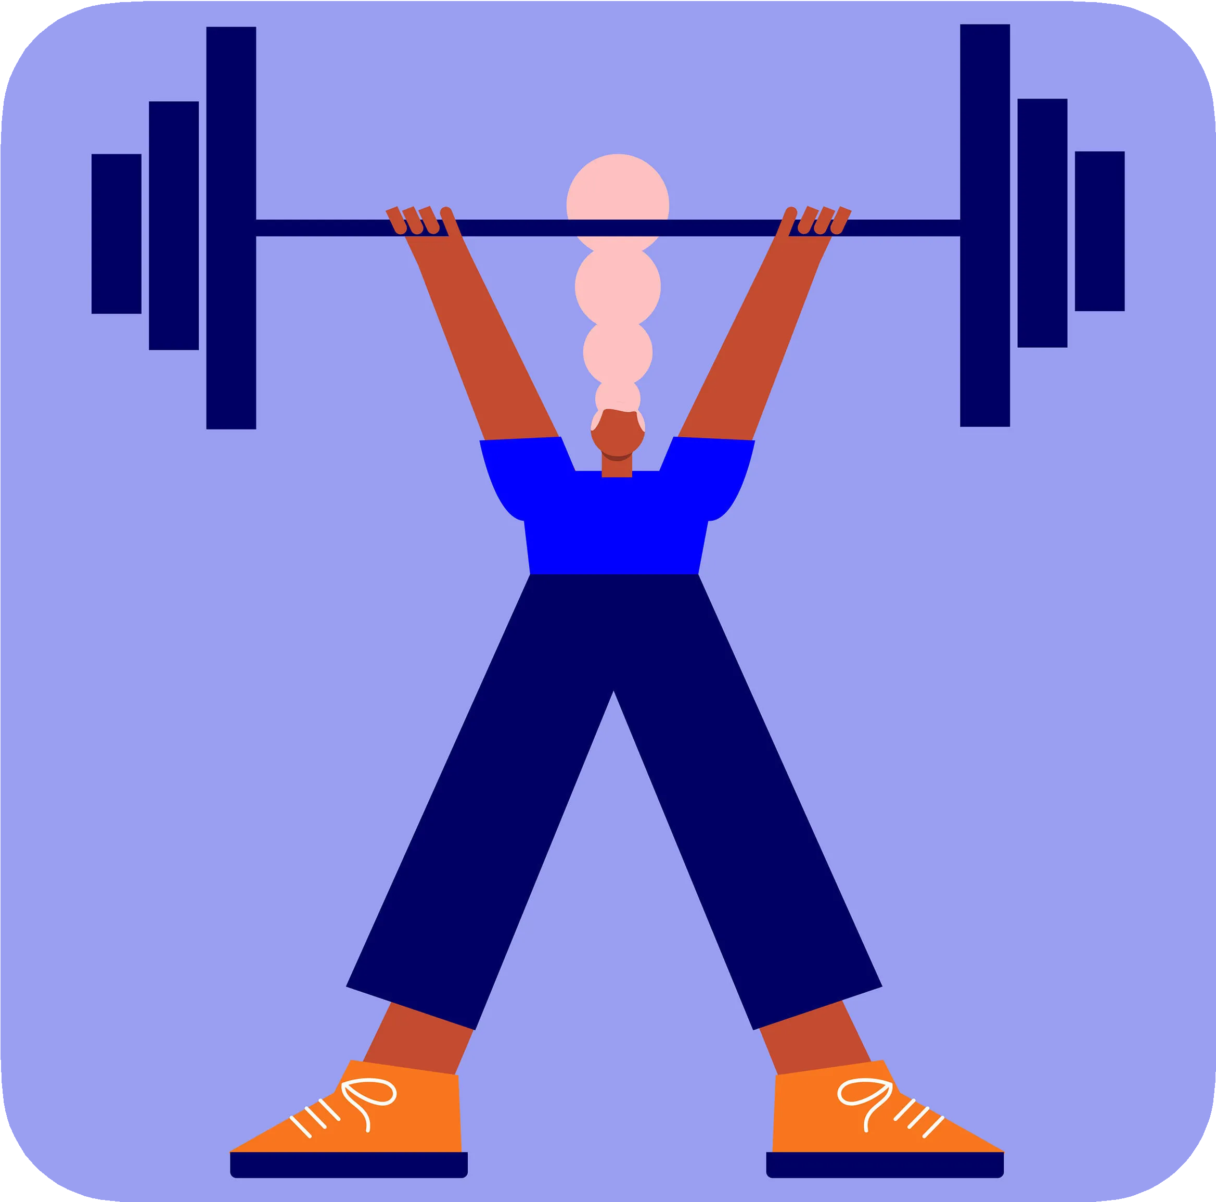
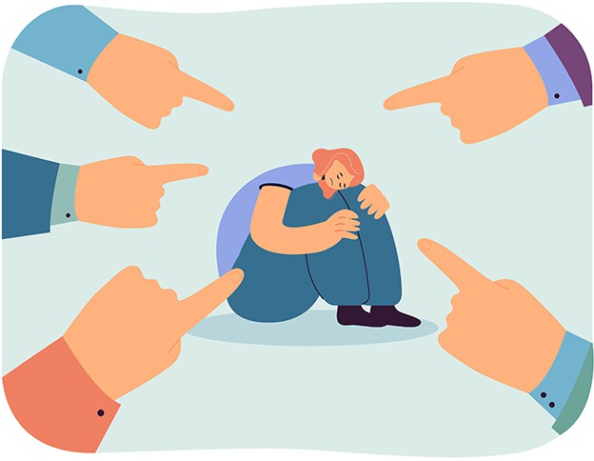
Problem Domain

Slide 4
Problem Domain
Approach mental health and healthy behaviors from a different perspective
Find a condition that affects a majority of the general population
Should be a subjective feeling

Slide 5
Stress
What does stress mean towards people living in the Bay Area? How might we help individuals understand themselves better through their stress?

Slide 6




Methodology: Participants
Julie (55)
Emi (20)
James (30)
Danna (17)

Slide 7
Methodology: Participants
Julie (55)
Emi (20)
James (30)
Danna (17)
Gather a wide demographic for diverse stress experiences

Slide 8
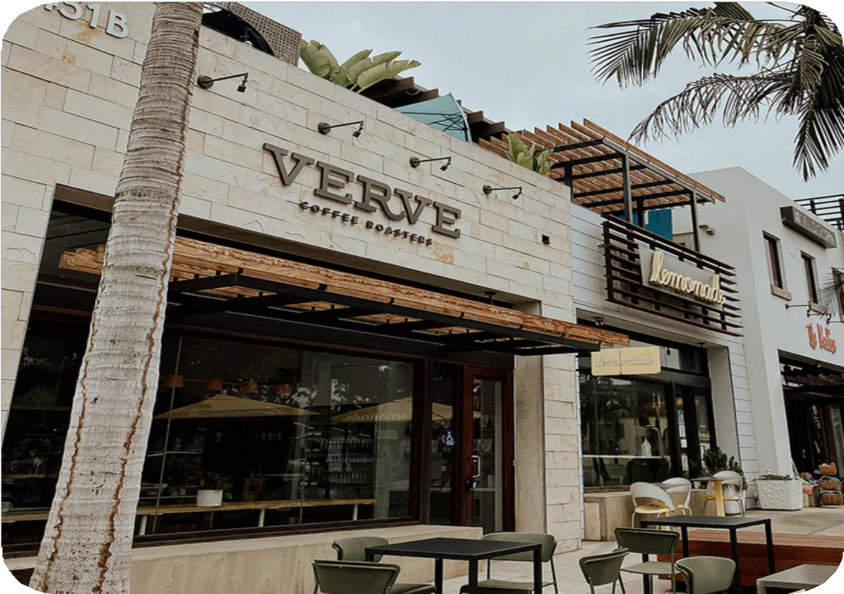


Methodology: Location

Slide 9
Methodology: Location
Places where different types of people visit

Slide 10




Methodology: Apparatus

Slide 11
Key Questions
How are you doing?

Slide 12
Key Questions
How are you doing?
Do you have a daily morning routine? What happens when you don’t do it?
What are your favorite parts/moments of your day? How do they make you feel?

Slide 13
Key Questions
How are you doing?
Do you have a daily morning routine? What happens when you don’t do it?
What are your favorite parts/moments of your day? How do they make you feel?
Do you typically feel any stress? How would you define stress?
Are there any techniques you use to try to lower your stress, what are they like?

Slide 14
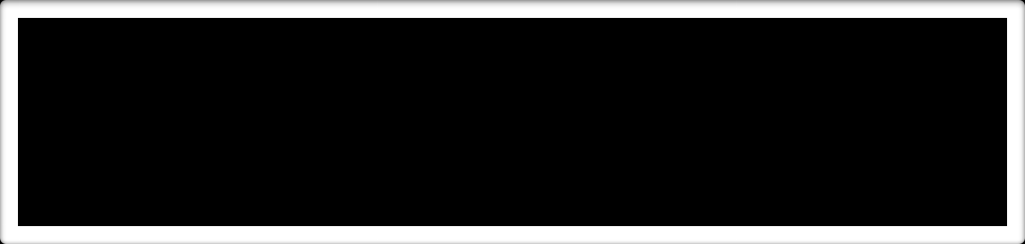


Key Quotes and Surprises
“My parents expect me to be a doctor or lawyer but what if that’s not what I want to do?”
“My father says I put 8 pounds of stuff into a 5 pound bag.”
“Water is the building blocks of life”
“I am very in-tune with my bodily signals.
When my chest tenses, I know I’m stressed.”
“Active stress is more obvious and apparent. Passive stress accumulates and is something you need to get rid of with breaks.”
“Life is a marathon, not a sprint”
“It’s hurtful to see that people feel bad about themselves”
“Make relationships, connections are priceless”

Slide 15
Key Quotes and Surprises
“My parents expect me to be a doctor or lawyer but wEhxatpifetchatta’stniootnwshat I want to
do?”
“My father says I p_{T}ut_{im}8 p_{e}ounds of stuff into a 5 pound bag.”
“WaterPishthyesbicuaildlinHgebalolctkhs of life”
“I am very_{P}in_{h}-_{y}tu_{s}n_{i}e_{c}w_{a}i_{l}th_{H}m_{e}y_{a}b_{l}o_{t}d_{h}ily signals.
When my chest tenses, I know I’m stressed.”
“Active stress is more obvious and apparent. Passive stress aAccmumbuilgatuesitaynd is something
you need to get rid of with breaks.”
“It’s hurtful t_{S}o _{y}se_{m}e t_{p}ha_{a}t_{t}p_{h}e_{y}ople feel bad about themselves”
“Life is a marTatihmone, not a sprint”
“Make _{C}rel_{o}at_{m}ion_{p}sh_{a}i_{n}ps_{i},_{o}c_{n}on_{s}n_{h}e_{i}c_{p}tions are priceless”

Slide 16

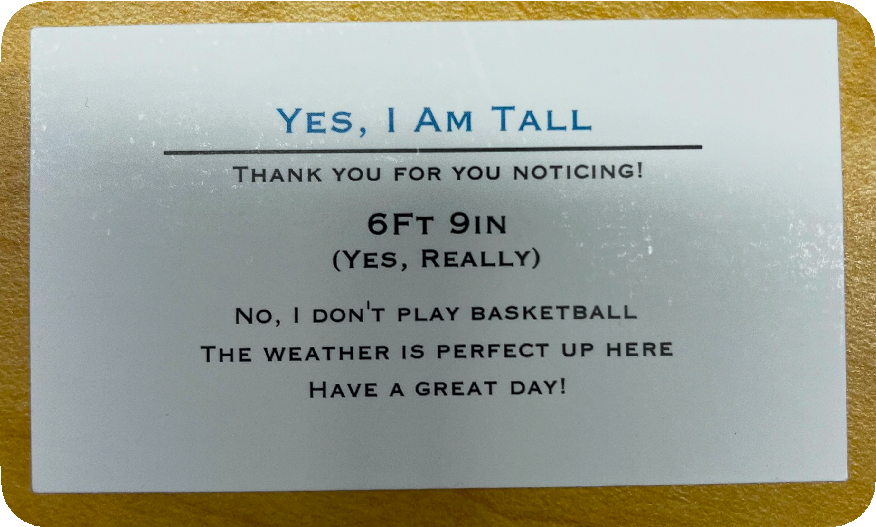
Analysis - Extreme User
James
Lifestyle
‣
‣
‣
‣
Left corporate sales job Spends his days job searching Is married and is trying for a kid
Workouts everyday in the mornings
‣
Has his stress down to a science
‣
‣
Calms down by drinking water
Knows he will feel anxious later in the day due to lower levels of dopamine
Accepts stress and manages it very well
‣
Emphasizes social interactions and listening to others
‣
‣
‣
“Silence can be a weapon & tool to understand others.” Thinks talking with others combats stress
Having an open-mind to stress is how you can keep it in balance

Slide 17
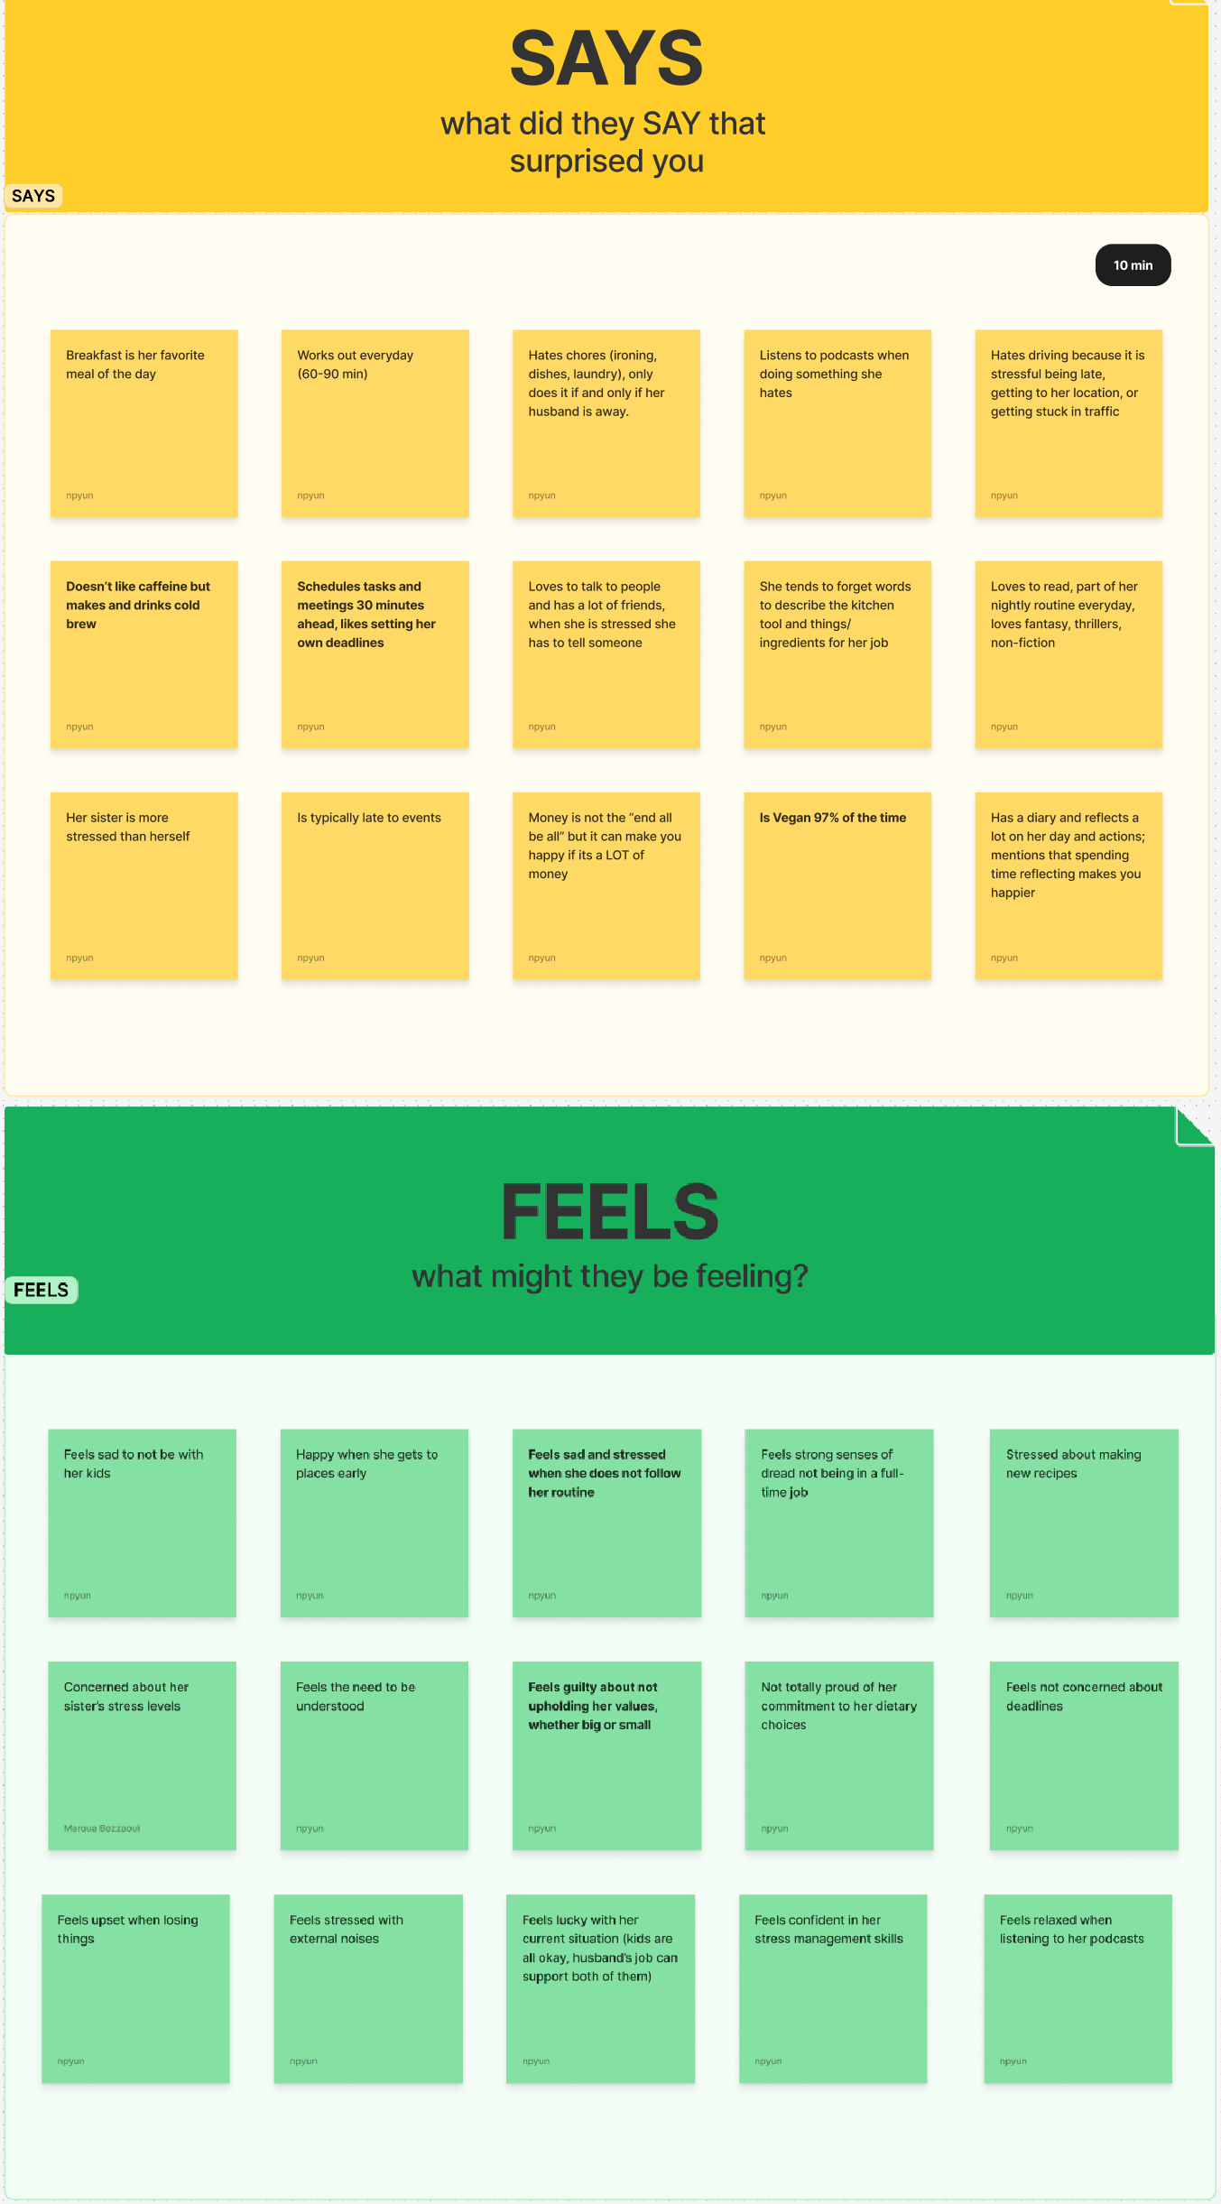
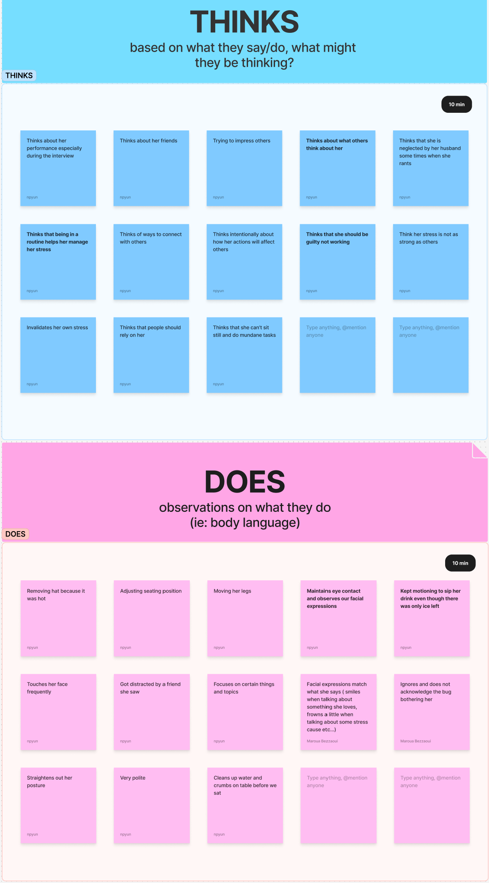
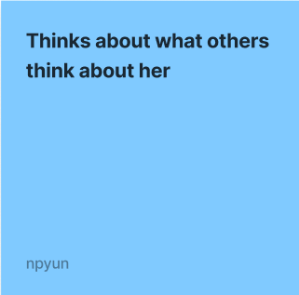
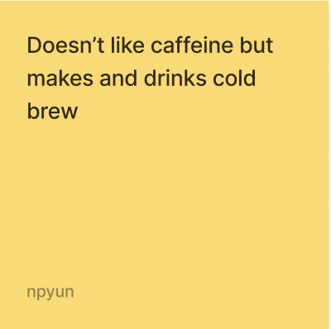
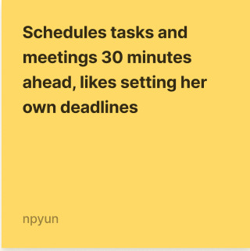
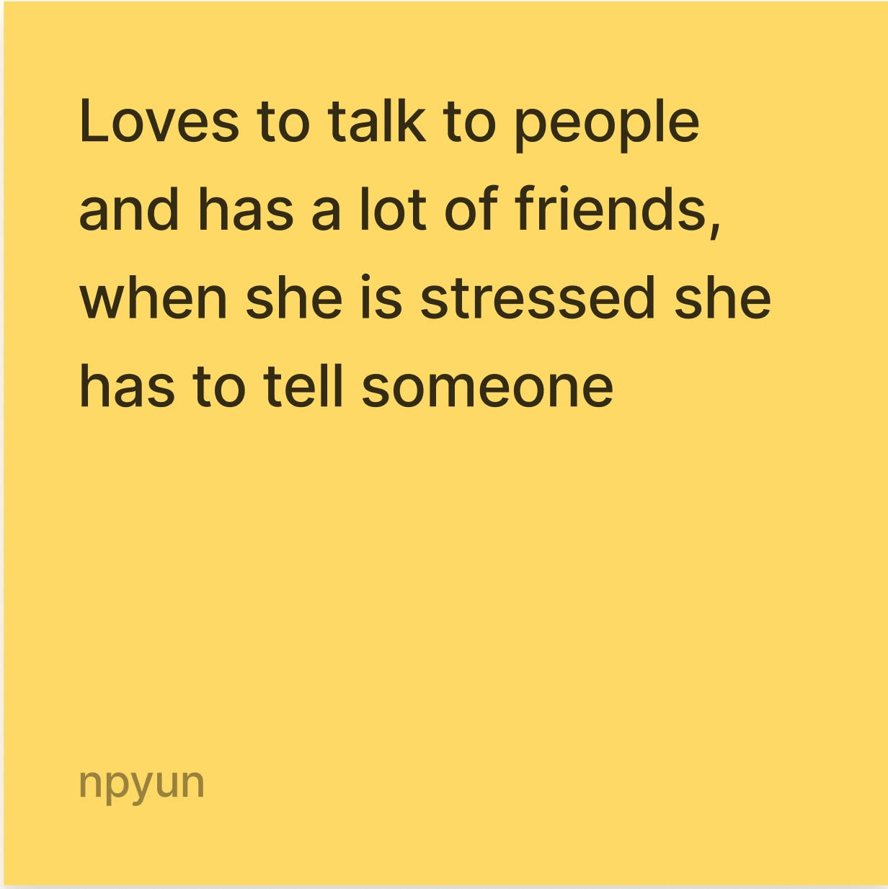
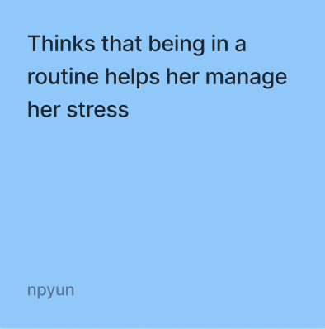
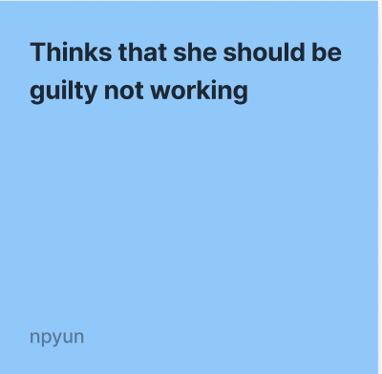

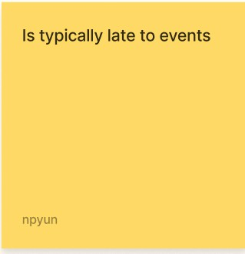
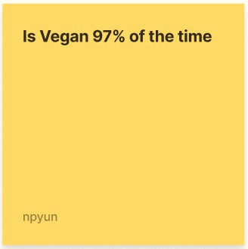
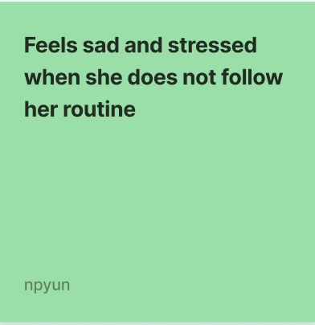
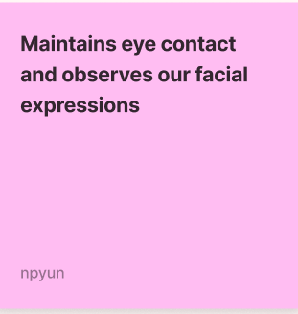
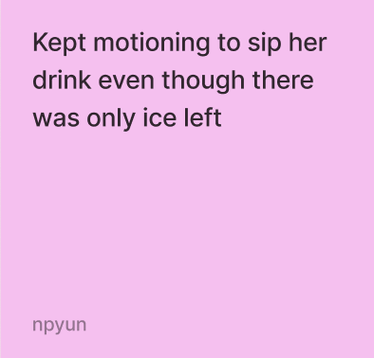

Julie
55 yrs old,Married mother of 2 with many hobbies, particular about her health

Slide 18




Analysis: Observations
Contradiction
Contradiction
10/3/2024
18

Slide 19





Analysis: Observations
Contradiction
Contradiction
Insight: Time management can affect their stress levels. Time is one thing people cannot
control.
Insight: Values are important but there seems to be a limit to how many a person can maintain.
Insight: Social interactions can be an outlet and inlet of stress. There seems
to be a delicate balance.
Insight:
When people set routines, they expect themselves to follow them.
19

Slide 20





Analysis: Inferences
Insights
Time management can affect their stress levels. Time is one thing people cannot control.
When people set routines, they expect themselves to follow them.
Social interactions can be an outlet and inlet of stress. There seems to be a delicate balance.
Values are important but there seems to be a limit to how many a person can maintain.
Inferences
The guilt surrounding “not doing enough” or “being unproductive” is a relevant stressor, especially in the Bay Area.
While people put schedules and routines in place with the intent to reduce stress, inevitable deviation from routines make them even more stressed.
Constantly seeking validation from others can be stressful.
People are very idealistic about what they can do and uphold, which can perpetuate stress.
10/3/2024

Slide 21
What did we learn?
Domain of Interest
People are willing to talk about how they deal with stress.
Stress can build up and go unnoticed. Smaller stressors can snowball and passively influence people’s well-beings.
Stress can be exerted in different forms. Understanding subtle hints of stress during the interview could better inform us about the interviewee.
Users
Most people we talked to had ways to manage their stress.
People used their past experiences to talk about their stress.
We wonder if our users provided idealistic answers. We would like to see how well they follow their stress management practices.
10/3/2024

Slide 22
Next Steps
Synthesis
Work on HMW and POV statements to identify specific needs
Further extrapolate content from our data to create questions for future interviews
Define different categories of stress
Interview
Go to different locations to increase sample size and variety
Interview individuals who do not have a clear practice of stress management
Talk to a domain expert to learn more about stress from a physiological standpoint
Ask for video recording to reevaluate body language
Scope
Narrow project scope
Determine group of intended users to target
Focus on type(s) of stress(es)
10/3/2024

